Slide 1
Karma and Jasmine

Slide 2
Karma – Test Runner
What is Karma
Able to spawn a web server and run tests against multiple browser.
Simple configuration and Instant feedback from the test.
Preferred the Test runner for Angular JS projects.
Why Karma use
Easy to debugging (directly in chrome)
Simple interaction with CI tools (Jenkis)
Describe the test with Jasmine, Mocha, Qunit etc

Slide 3
Jasmine
What is Jasmine
It is a Testing framework.
A behaviour driven framework for testing JS code.
Doesn’t depends on the other JS framework.
Does not require a DOM (Document Object Model).
It has a clean, obvious syntax for writing tests.

Slide 4
Continue...
Jasmine is an open-source framework and easily available in different versions like stand-alone, ruby gem, Node.js, etc.
Jasmine is one of the popular JavaScript unit testing frameworks which is capable of testing synchronous and asynchronous JavaScript code.

Slide 5
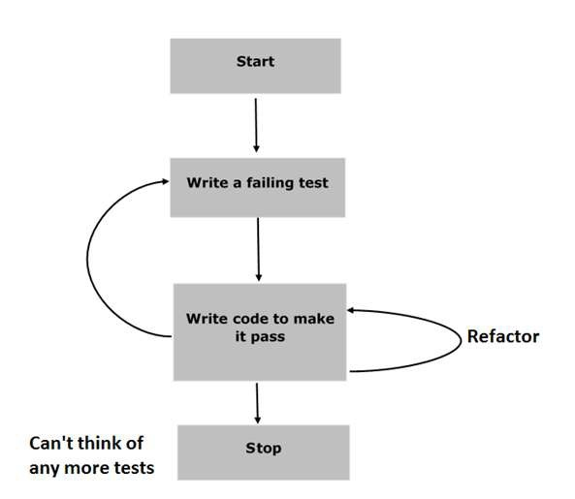
JasmineJS - BDD Architecture
Different phases of BDD framework.

Slide 6
JasmineJS - BDD Architecture Cont…
Step 1 − Start
In this phase, make the environment ready for Jasmine application.
Step 2 − Write a failing test
In this step, write the first ever test case. It is obvious that this test is going to fail because there is no such file or function to be tested.
Step 3 − Write a code to make it pass
In this phase, prepare the JavaScript file or function that needs to be tested. All the test cases prepared in the early stage should be successful.

Slide 7
JasmineJS - BDD Architecture Cont…
Step 4 − Refactor
Refactor is a very important phase of BDD model prepare many test cases for the particular application or function.
Step 5 − Stop
If everything is going well then the application must be ready and up. So we can consider this step as an end of our BDD application.

Slide 8
Jasmine suite
Suites : describe() your tests.
Used for describing your tests and wrap blocks of codes.
Divide your tests suites into sub components.
Can be nested under another describe() of further divide it.
Contains 1 or more specs and beforeEach() or afterEach() functions.

Slide 9
Jasmine Specs
Specs : it() should to this/should have
Describe your individual tests.
Usually will be sentence to describe what it will do.
Both of the describe() and it() are functions can contains any executable code necessary to implement the test.
Variable declared inside the described() are available to any it() block inside the same suite.

Slide 10
Spec
//This is test suite
describe("Test Suite", function() {
it("test spec", function() {
expect( expression ).toEqual(true);
});
});

Slide 11
Describe & IT block
Describe Block
Describe block is a part of Suite block. Like Suite block, it contains two parameters, one “the name of the describe block” and another “function declaration”.
IT Block
It goes within a describe block. This is the block which actually contains each unit test case.

Slide 12
Expect Block
Expect Block
Jasmine Expect allows you to write your expectation from the required function or JavaScript file. It comes under IT block. One IT block can have more than one Expect block.
Following is an example of Expect block.
This expect block provides a wide variety of methods to unit test JavaScript function or JavaScript file. Each of the Expect block is also known as a matcher. There are two different types of matchers, one inbuilt matcher and another user defined matchers.

Slide 13
Built in matcher
expect(fn).toThrow(e)
expect(instance).toBe(instance)
expect(mixed).toBeDefined()
expect(mixed).toBeFalsy()
expect(number).toBeGreatherThan(number)
expect(number).toEqual(number)
expect(mixed).toMatch(mixed)
expect(string).toContainer(string)

Slide 14
Equality Check Cont…
toEqual()
toEqual() is the simplest matcher present in the inbuilt library of Jasmine. It just matches whether the result of the operation given as an argument to this method matches with the result of it or not.
not.toEqual()
not.toEqual() works exactly opposite to toEqual(). not.toEqual() is used to check if the value does not match with the output of any function.

Slide 15
Equality Check Cont…
toBe()
toBe() matcher works in a similar way as toEqual(), however they are technically different from each other.
toBe() matcher matches with the type of the object whereas toEqual() matches with the equivalency of the result.

Slide 16
Equality Check
not.toBe()
not is nothing but a negation of the toBe() method. It fails when the expected result matches with the actual output of the function or JavaScript file.

Slide 17
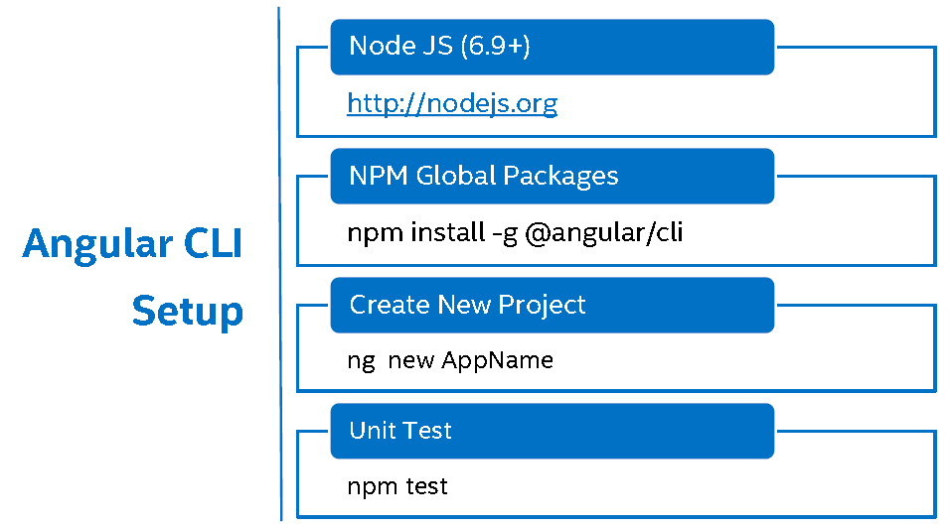

Slide 18
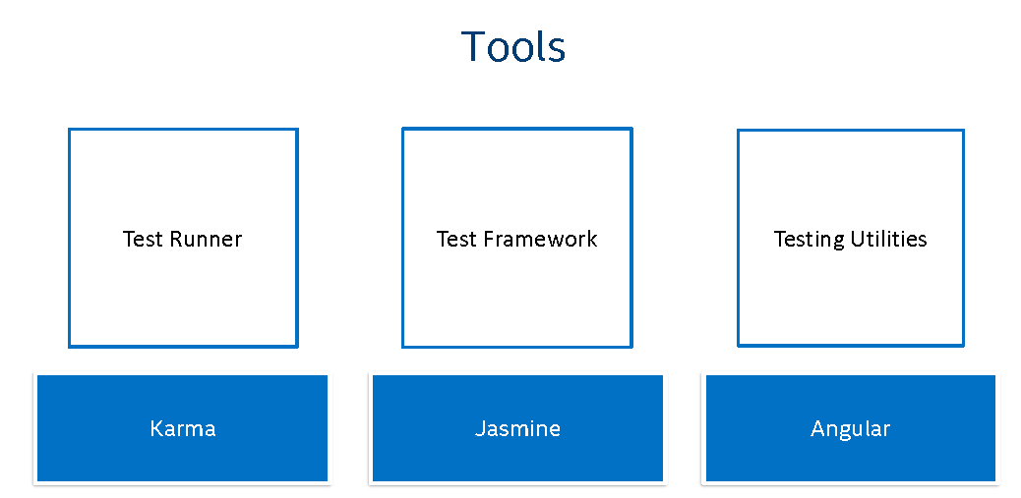

Slide 19
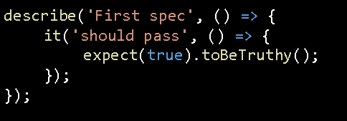
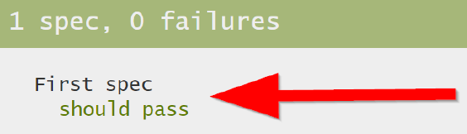

Slide 20
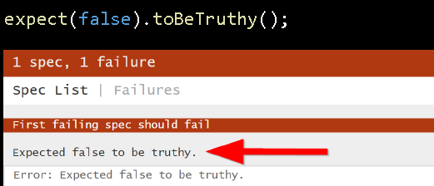

Slide 21
Component Test

Slide 22
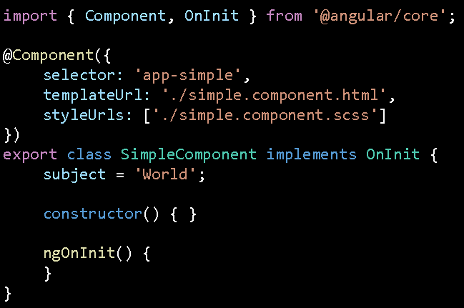


Slide 23
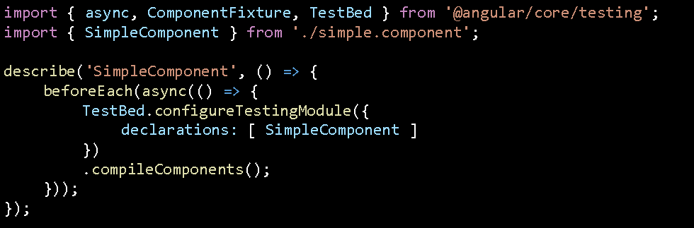

Slide 24


Slide 25
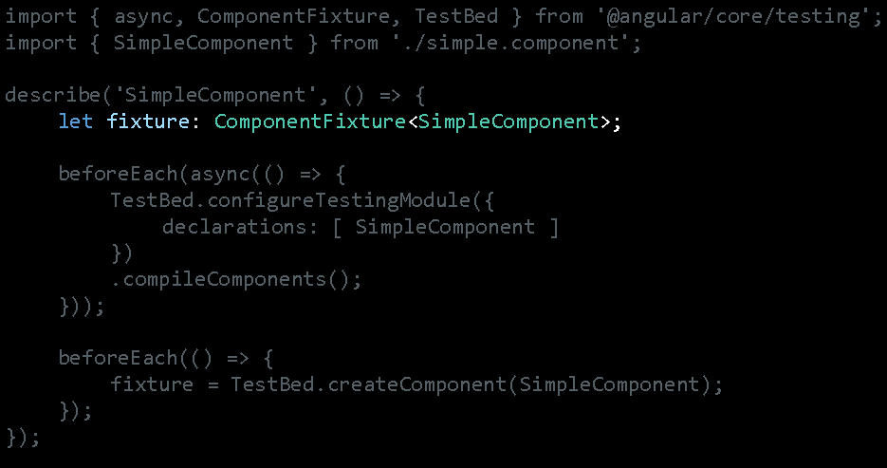

Slide 26
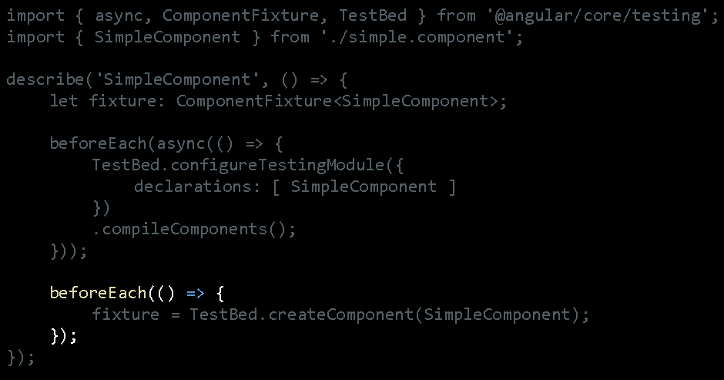

Slide 27


Slide 28
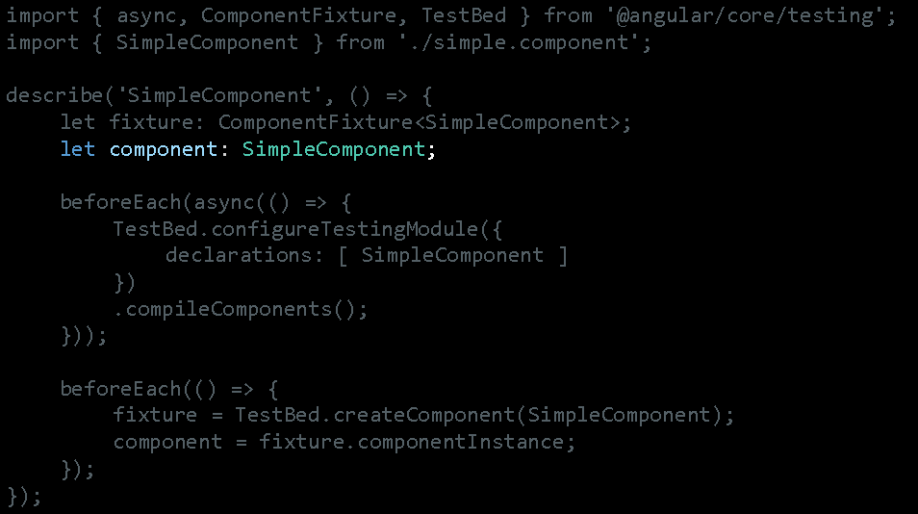

Slide 29
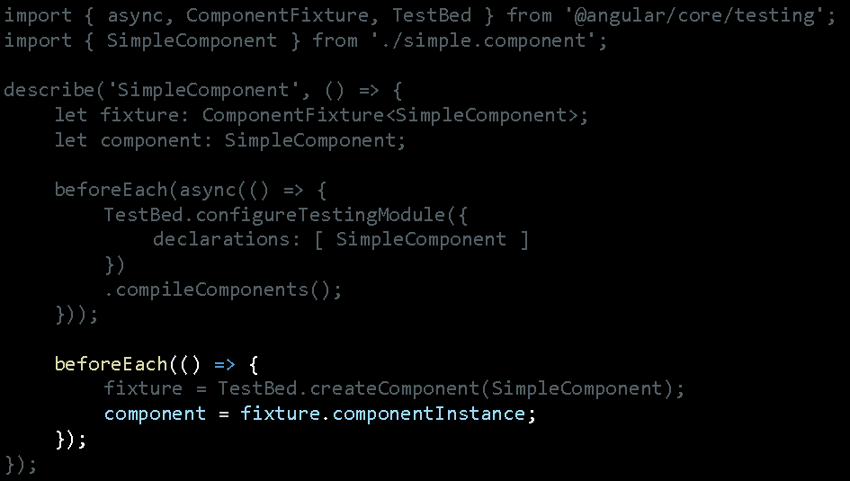

Slide 30
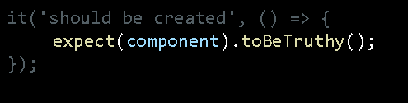

Slide 31


Slide 32
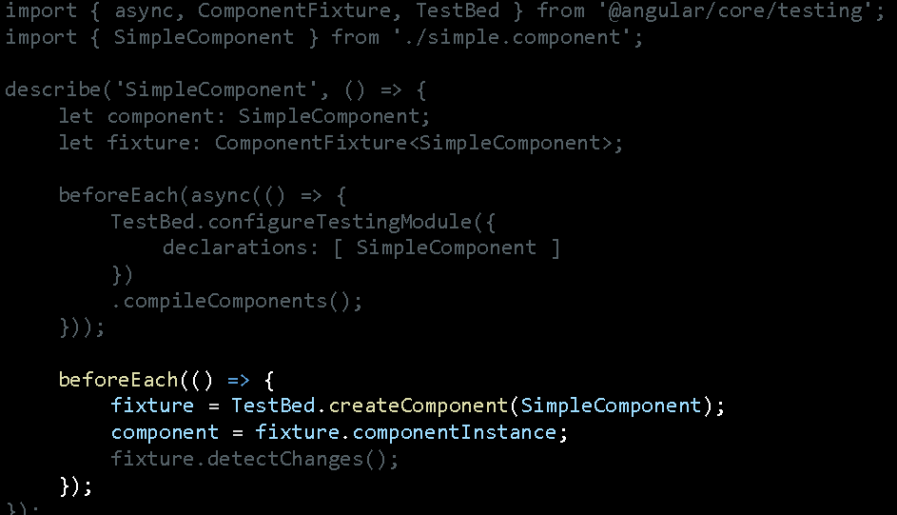

Slide 33
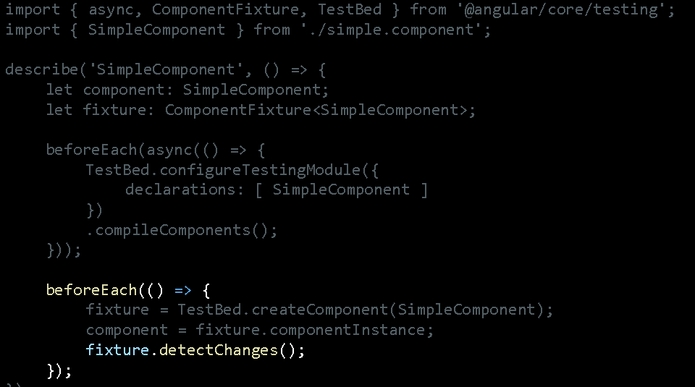

Slide 34
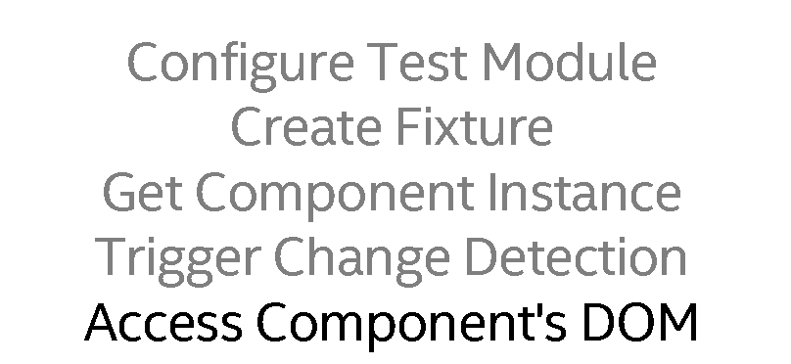

Slide 35
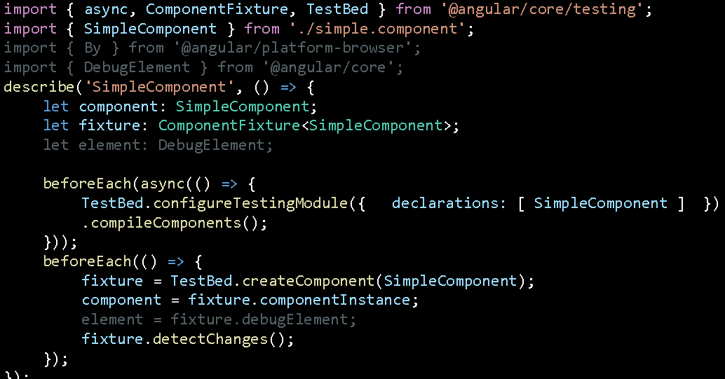

Slide 36
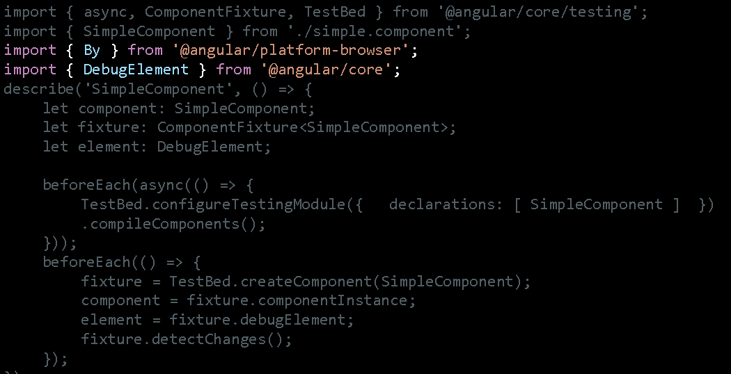

Slide 37

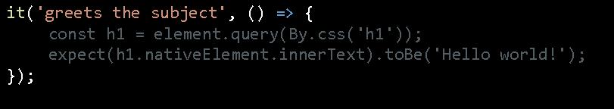

Slide 38
Component with Service

Slide 39
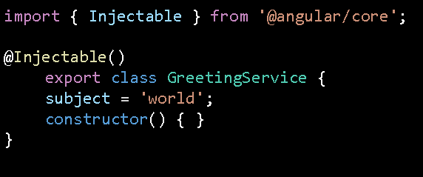

Slide 40
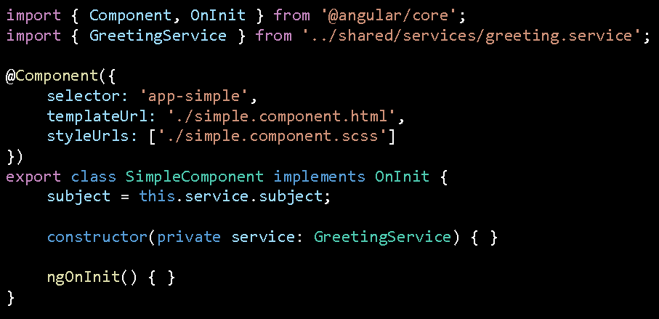

Slide 41
Template testing
//Template Testing it('should create the app', () => {
const fixture = TestBed.createComponent(AppComponent);
const app = fixture.debugElement.componentInstance;
expect(app).toBeTruthy();
});
it('should render title in a h1 tag', () => {
const fixture = TestBed.createComponent(AppComponent);
fixture.detectChanges();
const compiled = fixture.debugElement.nativeElement;
expect(compiled.querySelector('h1').textContent).toContain('Welcome to angular-testing!');
});

Slide 42
Continue...
it('should contains the tables', () => {
const fixture = TestBed.createComponent(AppComponent);
fixture.detectChanges();
const compiled = fixture.debugElement.nativeElement;
expect(compiled.querySelector("table")).toBeTruthy();
});
it('table value testing', () => {
const fixture = TestBed.createComponent(AppComponent);
fixture.detectChanges();
const compiled = fixture.debugElement.nativeElement;
expect(compiled.querySelector("#firstName").textContent).toContain("Raj");});

Slide 43
Component testing
//Component Testing it(`should have as title 'angular-testing'`, () => {
const fixture = TestBed.createComponent(AppComponent);
const app = fixture.debugElement.componentInstance;
expect(app.title).toEqual('angular-testing');
});
it(`Name variable testing `, () => {
const fixture = TestBed.createComponent(AppComponent);
const app = fixture.debugElement.componentInstance;
expect(app.name).toBeTruthy();
expect(app.name).toContain("Raj Deep");
});

Slide 44
it(`Number of Employee Records are `, () => {
const fixture = TestBed.createComponent(AppComponent);
const app = fixture.debugElement.componentInstance;
expect(app.employees.length).toEqual(4);
});

Slide 45
Service class
@Injectable()
export class CustomService { emp:Employee[];
constructor() {
this.emp=[
new Employee(100,"Ajay",20000),
new Employee(200,"Vijay",25000)
]
}
displayInfo():string{
return "Welcome to Custom Service";
} displayEmployees():Employee[]{
return this.emp;
}
}

Slide 46
Service testing
describe('Custom Service', () => {
beforeEach(async(() => {
TestBed.configureTestingModule({
imports: [
RouterTestingModule
],
declarations: [
AppComponent
],
providers:[CustomService]
}).compileComponents();
}));

Slide 47
Service testing code
//Service Testing it('Custom Service should be created', inject([CustomService],
(service: CustomService) => {
expect(service).toBeTruthy();
}));
it('Custom Service string message', inject([CustomService],
(service: CustomService) => {
expect(service.displayInfo()).toContain("Welcome to Custom Service");
}));

Slide 48
Continue...
xit('Custom Service employee array name', inject([CustomService],
(service: CustomService) => {
let employees = service.displayEmployees();
let name = employees[1].name;
expect(name).toContain("Vijay");
})); });

Slide 49
Employee service using Http service
@Injectable()
export class EmployeeService {
constructor(private httpClient:HttpClient){}
getEmployeeInfo():Observable<Employee[]>{
return this.httpClient.get<Employee[]>("http://localhost:9191/Rest/webapi/obj/getEmps");
}
storeEmployeeInOf():Observable<string>{
return this.httpClient.post("http://localhost:9191/Rest/webapi/obj/pathParamPost/Akash/Kale",{},{responseType:"text"});
}

Slide 50
Mock testing
describe('Employee Service - Mock Object ', () => {
beforeEach(async(() => {
TestBed.configureTestingModule({
imports: [
RouterTestingModule
],
declarations: [
AppComponent
],
providers:[{provide: EmployeeServiceFake, useClass: EmployeeServiceFake}]
}).compileComponents();
}));

Slide 51
Fake Service class
class EmployeeServiceFake {
emp:Employee[];
getEmployeeInfo():Observable<Employee[]>{
let e1 = new Employee(100,"Raj",12000);
let e2 = new Employee(101,"Ravi",14000);
let e3 = new Employee(102,"Raju",16000);
let e4 = new Employee(103,"Ramu",18000);
this.emp=[e1,e2,e3,e4];
return of(this.emp);
}
storeEmployeeInfo():Observable<string>{
return of("sucessfully store");
}
}

Slide 52
Fake Service testing code
it('Employee service post method - Mock Method', inject([EmployeeServiceFake],
(service: EmployeeServiceFake) => { service.storeEmployeeInfo().subscribe(data=>{
expect(data).toEqual("sucessfully store")
})
}));

Slide 53
Continue...
it('Employee Service get method - Mock Method', inject([EmployeeServiceFake],
(service: EmployeeServiceFake) => {
let employees = service.getEmployeeInfo().subscribe(emp=>{
let id = emp[0].id;
let name = emp[0].name;
let salary = emp[0].salary;
expect(id).toEqual(100);
expect(name).toContain("Raj");
expect(salary).toEqual(12000);
})
}));

